Slide 1

Europeana
Awareness Evaluation and Tracking Study – Poland, Italy and Norway - Wave 1
For Eleanor Kenny, British Library
By Simon McDonald I Business Director
simon@insites-consulting.com
Emma Hargreaves I Research Manager
emma@insites-consulting.com
Date April 4th 2013
www.insites-consulting.com
Ghent I Rotterdam I London I Timisoara I New York

Slide 2

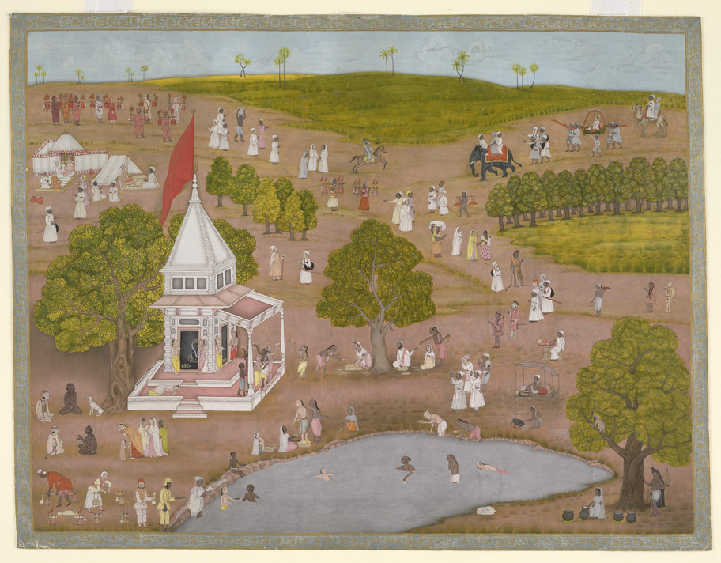

Agenda
Background & Objectives Overview
Method, Sample, Weighting
Awareness, Usage & Attitudes
Site Activation
Areas for Improvement
Q & A

Slide 3

Background & Objectives Overview

Slide 4
Background information
Europeana, Europe's “digital museum, library and archive” portal launched in 2008. The portal gives access to over 23 million cultural reference points such as films, books and museum objects contributed by over 2,000 European GLAMS.
PR campaigns have already been rolled out in some EU member states, and the programme will continue from 2012
Up to this point, no study has been conducted which can assess target user groups awareness, attitudes and usage of the site.
The objectives of this study were to measure awareness, usage, and recommendation of Europeana at an early stage - before campaigns began and allow us to benchmark any future movements.
A further study will be conducted later in the year (timing TBD) to measure shifts in attitudes and awareness in the same three markets to understand successes
Background information

Slide 5
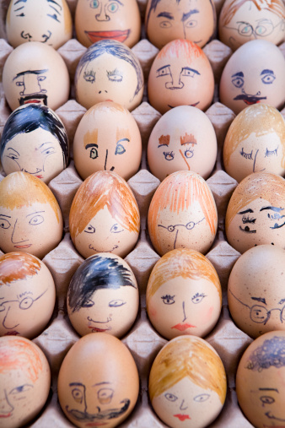
Method, Sample and Weighting

Slide 6




Dipstick to measure awareness, usage, recommendation and attitudes to Europeana prior to marketing campaigns
Quantitative
Poland
Online
Italy
Norway
Survey
500 completed interviews in each market

Slide 7
Quantitative Study in Three Countries
Awareness and Usage
Screening
Activation
Screened for:
Interest in arts/culture/history
Visited museums, exhibitions, libraries, events in last six months
Allows for universe estimation
Awareness and usage of Europeana and competitive set
Likelihood to visit again and recommend
Source of awareness
Attitudes to Europeana
All respondents directed to Europeana and asked:
Attitude statements
Likelihood of returning/recommending
Likes/dislikes/suggestions

Slide 8
Sample - Screening
All respondents had to have:
Interest in arts/culture/history
Visited museums, exhibitions, libraries, events in last six months
 | Eligibility rates
Italy | 60.4%
Norway | 46.9%
Poland | 73.1%
Total | 64.5% = 45.9m people
 | Unweighted screened sample | Weighted and grossed
Italy | 516 | 24.3m (52.9%)
Norway | 505 | 1.5m (3.3%)
Poland | 530 | 20.1m (43.8%)
Total | 1,551 | 45.9m people

Slide 9
Sample - Weighting
 | Unweighted screened sample | Weighted and grossed
Italy | 516 (33.2%) | 24.3m (52.9%)
Norway | 505 (32.6%) | 1.5m (3.3%)
Poland | 530 (34.2%) | 20.1m (43.8%)
Total | 1,551 respondents | 45.9m people

Slide 10
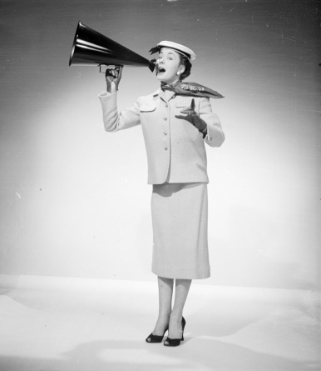
Awareness
Pre-activation

Slide 11


Overall Awareness of Europeana
11

Slide 12
Overall Awareness of Europeana is low
Only 9% of all respondents are aware of Europeana
12%
Italy
4%
Norway
6%
Poland
12

Slide 13



Wikipedia currently dominates consumer mindset
AIDED
AWARENESS
Objectives
TOTAL
Wikipedia
84% | 80% | 83% | 89%
49% | 52% | 24% | 48%
27% | 27% | 17% | 29%
9% | 12% | 4% | 6%
4% | 5% | 10% | 4%
Google Books
Google Art Project
europeana
None of these
MARKET SPECIFIC:
www.Digitaltmuseum.no = 27%
www.culturitalia.it = 22%
www.Arkivportalen.no = 14%
www.san.beniculturali.it = 19%
cyfrowe.mnw.art.pl = 32%
www.internetculturale.it = 14%
fbc.pionier.net.pl = 17%
Q8. Which of the following websites which contain art, museum collections, digitised books and cultural history are you aware of?
Base: All n=1551; Italy n=516; Norway n=505; Poland n=530

Slide 14


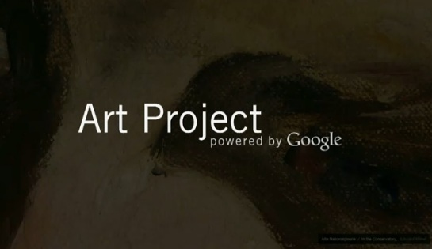
Spontaneous awareness within the category is very low
AIDED & SPONTANEOUS
AWARENESS
Objectives
TOTAL SAMPLE
80% |  | 83% |  | 89%
7% |  | 6% |  | 4%
52% |  | 24% |  | 48%
1% |  | 0% |  | 0%
27% |  | 17% |  | 29%
1% |  | 0% |  | 0%
12% |  | 4% |  | 6%
0% |  | 0% |  | 0%
5% |  | 10% |  | 4%
58% |  | 63% |  | 61%
Q7. There are a number of websites which contain art, museum collections, digitised books and background information about artists, culture, books and history collections online. Can you please tell us which of these websites you can name?
Q8. Which of the following websites which contain art, museum collections, digitised books and cultural history are you aware of?
Base: All n=1551; Italy n=516; Norway n=505; Poland n=530

Slide 15



The internet currently plays a key role in the awareness of europeana
AWARENESS
SOURCE
Objectives
34%: INTERNET 26%: FRIENDS/COLLEAGUES
32%: SEARCH ENGINE 20%: SOCIAL MEDIA
Q11. How did you first become aware of the europeana website?
Base: All aware of europeana n=118; Italy n=65; Norway n=18; Poland n=35

Slide 16
Brand fans...get those who use and like you to talk about you!
AWARENESS
SOURCE
Objectives
TOTAL SAMPLE
Awareness via a library or musuem is more prevalent in Poland, while social media plays a greater role in Italy.
Q11. How did you first become aware of the europeana website?
Base: All aware of europeana n=118; Italy n=65; Norway n=18; Poland n=35

Slide 17

Website Usage
Pre-activation

Slide 18
Over half of those aware have used europeana in the past week – is europeana a threat for Google Books…
WEBSITE
USAGE
Objectives
TOTAL SAMPLE
PAST MONTH
PAST WEEK
Awareness position
93% |  | 78%
80% |  | 54%
78% |  | 46%
67% |  | 38%
1st
4th
2nd
3rd
Q9. And which have you visited in the last six months at all? Please indicate when you last visited each site.
Base: Aware of website; Wikipedia n=1303; europeana n=118; Google Books n=642; Google Art Project n=392

Slide 19
Is Europeana a threat for Google Books….not without awareness
WEBSITE USAGE
TOTAL

Slide 20
Detailed usage
WEBSITE
USAGE
Objectives
www.san.beniculturali.it
www.internetculturale.it
www.Arkivportalen.no
www.culturitalia.it
www.Digitaltmuseum.no
cyfrowe.mnw.art.pl
fbc.pionier.net.pl
Yesterday | 47% | 17% | 15% | 10% |  | 46% | 13% | 19% |  | 3% | 2% |  | 8% | 5%
Past 7 days | 31% | 37% | 31% | 28% |  | 31% | 30% | 25% |  | 11% | 8% |  | 15% | 13%
Past 4 weeks | 15% | 25% | 31% | 29% |  | 21% | 30% | 21% |  | 24% | 26% |  | 33% | 29%
Past six months | 6% | 16% | 18% | 21% |  | 2% | 19% | 20% |  | 28% | 35% |  | 29% | 36%
Longer ago/Never | 2% | 5% | 4% | 12% |  | 0% | 8% | 15% |  | 34% | 28% |  | 16% | 17%
Past 4 weeks | 93% | 80% | 78% | 67% |  | 98% | 73% | 65% |  | 38% | 37% |  | 55% | 46%
Past week | 78% | 54% | 46% | 38% |  | 77% | 43% | 44% |  | 14% | 10% |  | 23% | 18%
Q9. And which have you visited in the last six months at all? Please indicate when you last visited each site.
Base: Aware of website; Wikipedia n=1303; europeana n=118; Google Books n=642; Google Art Project n=392

Slide 21
There is a slight drop in potential future usage in comparison with google books
FUTURE
USAGE
Objectives
LIKELY
UNLIKELY
Current usage position
97% |  | 3%
93% |  | 7%
90% |  | 10%
91% |  | 9%
1st
3rd
2nd
4th
Q10. And how likely are you to visit each of these sites in the next six months? Please indicate for each site
Base: Aware of website; Wikipedia n=1303; europeana n=118; Google Books n=642; Google Art Project n=392

Slide 22
Potential future usage amongst total audience is low due to low current awareness
FUTURE USAGE
TOTAL

Slide 23
Conversion rates from awareness to visits to recommend.
Health Check
TOTAL
Objectives
 | Total
a) Awareness | 9%
b) Visited (last 4 weeks) | 7.1%
Conversion (b/a) | 79
c) Visited last 6 months | 8.6%
Conversion (c/a) | 95
d) Likely to visit again (ever) | 8.1%
Conversion (d/a) | 90
e) Very Likely to visit again | 5.4%
Conversion (e/a) | 61
f) Recommend | 6.6%
Conversion (f/a) | 73
Good conversion form awareness to visits
Drop off in very likely to visit again (attention to usability)
High levels of future recommendation – how to leverage the recommendations

Slide 24
Good conversion in Italy and Poland. Poor in Norway.
Health Check
TOTAL
Objectives
 | Total | Italy | Norway | Poland
a) Awareness | 9% | 12% | 4% | 6%
b) Visited (last 4 weeks) | 7.1% | 10.4% | 1.3% | 4.0%
Conversion (b/a) | 79 | 87 | 33 | 67
c) Visited last 6 months | 8.6% | 11.8% | 3.2% | 5.3%
Conversion (c/a) | 95 | 98 | 79 | 89
d) Likely to visit again (ever) | 8.1% | 10.7% | 2.9% | 5.5%
Conversion (d/a) | 90 | 89 | 73 | 91
e) Very Likely to visit again | 5.4% | 7.4% | 1.1% | 3.7%
Conversion (e/a) | 61 | 62 | 28 | 62
f) Recommend | 6.6% | 8.5% | 2.2% | 4.7%
Conversion (f/a) | 73 | 71 | 55 | 79

Slide 25

Challenge to bring users back to the website
P*
Awareness is currently low
But conversion (usage) is competitive
Doesn’t always translate to future usage
* P=Position among europeana, Wikipedia, Google Books & Google Art Project i.e. those websites present in all markets
4th
2nd
3rd

Slide 26

Attitudes towards europeana
Pre-activation

Slide 27


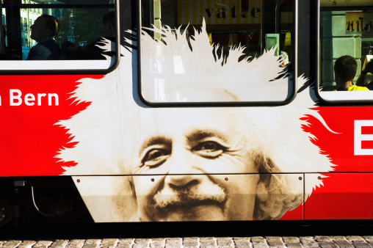
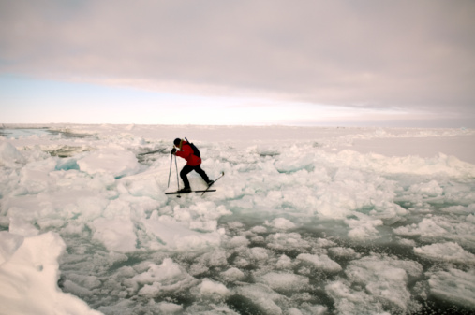
CURRENT STRENGTHS
EUROPEANA
Objectives
44%
….a site where you can access millions of books, films, paintings and museum objects
42%
…is an authoritative source of cultural information
40%
provides a new way to explore the things I am interested in
* Top box agreement with statement (totally agree)
BUT is europeana unique? 23% are unsure...
Q12, What have you heard about Europeana? Please answer each statement, saying how much you agree or disagree
Base: All aware of europeana n=118; Italy n=65; Norway n=18; Poland n=35

Slide 28
Those aware have strong perceptions of europeana. BUT are unclear what is unique
CURRENT STRENGTHS
FUTURE
EUROPEANA
Objectives
AGREE
DISAGREE
Recommendation
73% |  | 11%
72% |  | 13%
73% |  | 11%
71% |  | 9%
65% |  | 12%
Site with millions of books etc.
Authoritative source
New way to explore
Can get the same somewhere else
Recommendation, don’t know:
3% 6% 0%
Q12, What have you heard about Europeana? Please answer each statement, saying how much you agree or disagree
Base: All aware of europeana n=118; Italy n=65; Norway n=18; Poland n=35

Slide 29
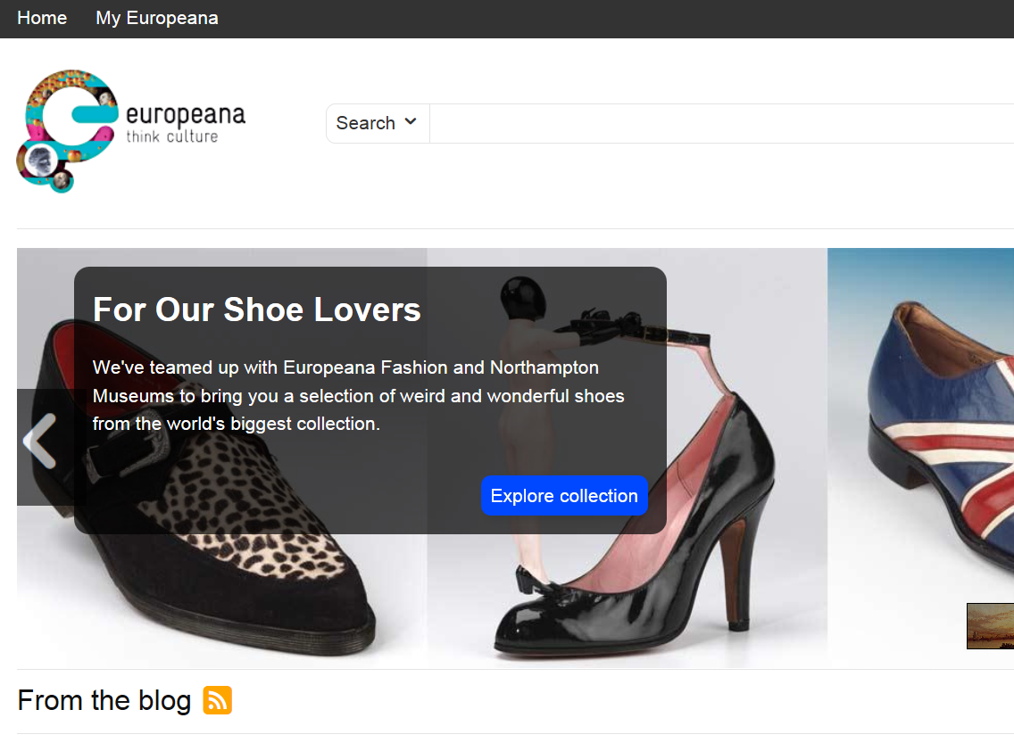
Activation
Survey directs participants to the webpage of europeana…
“Please take a few minutes to take a look at the website, and then come back to this window and answer the following short questions. “
Those already aware of europeana also take part in this task.

Slide 30
Attitudes towards europeana
Post-activation

Slide 31
Once shown the site, perceptions are positive. With same caveat re: uniqueness
FUTURE
WEBSITE
ACTIVATION
Objectives
Pre-activation
(already aware)
Post-activation
(already aware)
Post-activation
(NOT aware)
TOTAL SAMPLE
Difference %
Agree
Disagree
Agree
Disagree
Agree
Disagree
Agree
Disagree
Site with millions of books etc.
72% |  | 11%
71% |  | 9%
73% |  | 11%
73% |  | 11%
NA |  | NA
NA |  | NA
65% |  | 12%
73% |  | 11%
73% |  | 12%
72% |  | 13%
71% |  | 10%
71% |  | 15%
67% |  | 15%
59% |  | 17%
61% |  | 6%
62% |  | 7%
64% |  | 7%
62% |  | 4%
64% |  | 11%
51% |  | 12%
52% |  | 9%
-12 |  | -5
-11 |  | -5
-8 |  | -6
-9 |  | -6
-7 |  | -4
-16 |  | -3
-7 |  | -8
New way to explore
Recommendation
Authoritative source
Easy to navigate
Find most things I wanted
Can get the same somewhere else
Q13. Now that you have visited the Europeana website, please take a look at the statements below. Please answer each statement, saying how much you agree or disagree
Base: Already aware of europeana n=118; not aware n=1433.

Slide 32
Much work to be done in Norway to enthuse potential users
FUTURE
WEBSITE
ACTIVATION
Objectives
TOTAL SAMPLE
Post-activation
(NOT aware)
Post-activation
(NOT aware)
Post-activation
(NOT aware)
Post-activation
(NOT aware)
Agree
Disagree
Agree
Disagree
Agree
Disagree
Agree
Disagree
Site with millions of books etc.
61% |  | 6%
62% |  | 7%
64% |  | 7%
62% |  | 4%
64% |  | 11%
51% |  | 12%
52% |  | 9%
60% |  | 6%
62% |  | 8%
64% |  | 6%
63% |  | 4%
62% |  | 11%
50% |  | 9%
50% |  | 9%
46% |  | 2%
54% |  | 7%
46% |  | 7%
40% |  | 5%
47% |  | 16%
35% |  | 11%
33% |  | 7%
63% |  | 6%
64% |  | 7%
66% |  | 8%
63% |  | 4%
67% |  | 11%
53% |  | 16%
56% |  | 10%
New way to explore
Recommendation
Authoritative source
Easy to navigate
Find most things I wanted
Can get the same somewhere else
Q13. Now that you have visited the Europeana website, please take a look at the statements below. Please answer each statement, saying how much you agree or disagree
Base: Not aware – Italy n=451; Norway n=487; Poland n=495

Slide 33
Usage Intention
Post-activation

Slide 34
Future usage
FUTURE
CURRENT USAGE
95% P6M
Objectives
P6M = Past 6 months
Pre-activation
(already aware) future usage
Post-activation
(already aware) future usage
Post-activation
(NOT aware) future usage
LIKELY
UNLIKELY
LIKELY
UNLIKELY
LIKELY
UNLIKELY
90% |  | 10%
93% |  | 7%
80% |  | 20%
Very | Quite
61% | 28%
Not very | Not at all
9% | 1%
Very | Quite
63% | 30%
Not very | Not at all
5% | 2%
Very | Quite
32% | 49%
Not very | Not at all
18% | 2%
Q9. And which have you visited in the last six months at all? Please indicate when you last visited each site.
Q10. And how likely are you to visit each of these sites in the next six months? Please indicate for each site
Q14. How likely are you to visit this site again in the future?
Base: Already aware of europeana n=118; not aware n=1433.

Slide 35

What are people saying about europeana?
Post-activation

Slide 36


1. Interesting & useful content
“Seems like a very original and interesting site, it collects things that otherwise would be impossible to find on the Internet.”
LIKES
2. To seek information & to be informed – general or in relation to a specific event/exhibition etc.
3. To learn...to expand current knowledge or to explore the site in more detail.
4. Is detailed and complete with a wealth of information
5. Easy to navigate and search
Why are you likely to visit the site again? What made makes you want to come back?
Base: Very / quite likely to visit europeana again n=1166

Slide 37

1. Language issues/constraints
“For those unfamiliar with other languages, like me, it becomes a useless site.”
DISLIKES
2. User-freindliness - “Is not very intuitive”
3. Preference for other sites – “These are topics that interest me but I can find them elsewhere.”
4. Unclear & complex – “A little complicated compared to other sites, it takes more time to get results.” & “Seems too high class, built for academics.”
5. Layout & design – “Since the design is also a bit boring and does not invite me to further explore the site.”
Why are you not likely to visit the site again? What did you not like about the site?.
Base: Not very likely / not at all likely to visit europeana again n=385

Slide 38
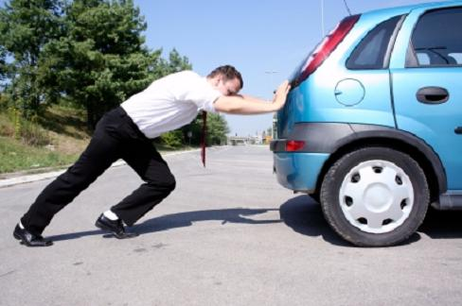
How to drive traffic to the site
Post-activation

Slide 39
DRIVERS
TO WEBSITE
Language
Objectives
1
Extend/complete translation
Graphics
2
Enrich & attractive
Navigation
3
Intuitive & transparent
Design
4
Visually sell yourself
Content and Curation
5
Enrich, expand & enhance

Slide 40
Language is a barrier to utilise the site, improved graphics will encourage repeat visits
DRIVERS
TO WEBSITE
Objectives
Language & translation
Graphics
The extent of the current translations is a barrier: translations are limited i.e. they do not extend to all functions/sections of the website.
Users commented that despite selecting their preferred language, majority of the information appears in English.
Some believed this was a fault, whilst others believe it makes the site unusable.
Demand to improve the graphics: current graphics appear unattractive and deters users from returning.
Graphics and images should be…
More appealing
Colourful & vivid
Higher in volume
Better quality
“It is accessible only to those who know the English language.”
“Certainly the graphics may be revised as currently they do not attract much and seem almost boring even for a person who visits the site for the first time.
“Although there is an option for the Italian language, it's only valid for the top menu, the rest is in English.”
“I found it a little scarce and unattractive ... maybe some nice artistic images may help.”
“It is not translated in Italian or maybe the translation is faulty.”
“More inviting images and more colour when it has to do with art. It did not look very creative.”

Slide 41
Navigation and user experience can be optimised through design, search and signposts
DRIVERS
TO WEBSITE
Objectives
Navigation
Design
Simpler, easier & clearer: current design means navigation is not intuitive.
Whilst the limited availability of translations will impact on ease of navigation, there is demand for a clearer understanding of content and topics on the site.
Overall need to simplify the navigation, making the site accessible to more users.
Exiting, colourful & inviting: opportunity to ‘delight’ users with improved content and homepage.
It’s not clear to everyone from the homepage, what to expect from the site.
Combined with improved graphics, users recommend improving the layout with clearer paths for navigation.
“More transparent site / clear message of what the page can offer me. The site is rather inaccessible.”
“Change the design and text so it becomes more obvious to the user.”
“Improved navigation - Intuitive.”
“A more user friendly summary of the content.”
“At the moment, the artwork does not attract my attention.”
“The site does not navigate well, there should be a index of topics.”
“It should be clear from the first click, what I can use the site for.”
“A more colourful site, better graphics.”

Slide 42
Be the curator. Direct and enhance through special features and refreshed content.
DRIVERS
TO WEBSITE
Objectives
Richer & more detailed: current content can be richer. Offering more text and images within the search results.
Recommendation to ensure content is refreshed, updated and always something new!
Special features appreciated.
Content and curation
“More search results and texts on a specific topic.”
“Several more of these special features would be nice.”
“More info, photos, maps, images, and deeper investigation.”

Slide 43

Who will help you promote the site?

Slide 44
Create an Advocacy Barometer
Advocates
Indifferent
Opponents

Slide 45
Advocacy Barometer – Take the opponents away from the advocates to give the barometer score
+57 All post activation
Advocates
Opponents
+100
0
-100

Slide 46
Advocacy Barometer – Chase the Promoters
+63
All v. int. in arts
+57
All post activation
Advocates
Opponents
+100
0
-100
+76
visited google arts past 4 weeks
+62
work in culture/ education

Slide 47
Summary
Awareness is currently low – highest in Italy, lowest in Norway
Attitudes to the website is positive
Visits amongst those aware are high – visits amongst total population are low
But there are many opportunities to enhance the user experience
Norway is a challenge
Drive awareness through
  Chasing the promoters
  The internet as your friend
  Special features
Shore up repeat visits
  Design and navigation
  Be unique
  Be a curator, not an encyclopaedia

Slide 48
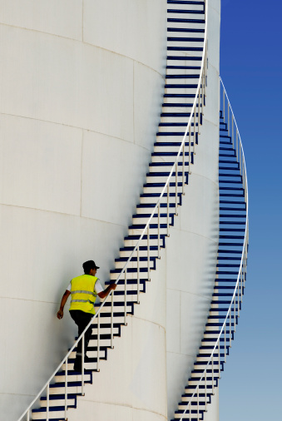
Next Steps
Final deck/reporting format
Schedule wave 2 Fieldwork dates:
Italy
Norway
Poland
Has europeana undertaken user experience research?

